Slide 1
TSDS Upgrade Support Meeting
ESC Region 11
December 13th

Slide 2
Winter is:
The bridge between letting go and embracing growth
The knowledge that slowing down is necessary
The belief that even the darkest of times will pass
The season of rest, of making room for what will come

Slide 3
Table of contents.
02 - Leavers/Underreported Students
01 - DMC Update
03 - ECDS Loads
04 - RFT

Slide 4
Table of contents.
05 - Eco Dis/PK
06- Documents
07 – Holiday Schedule
08 - Comments

Slide 5
1 – DMC Updates
At the request of ESCs and multiple districts, TSDS has updated the Search feature to include all entities, even if there is no data (“0” Records) in the IODS for that entity.

Slide 6
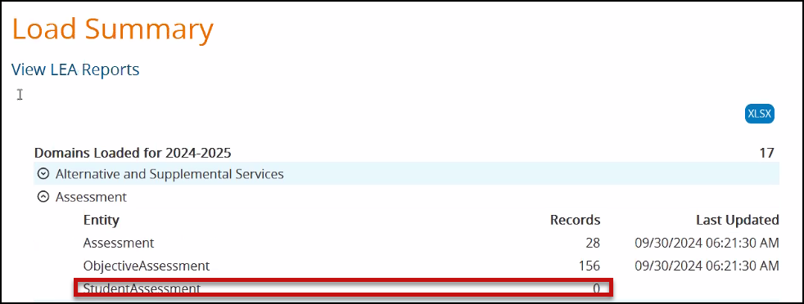
1 – DMC Updates

Slide 7
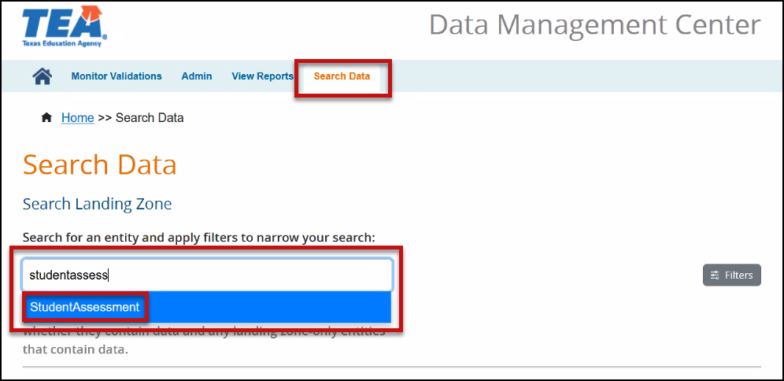
1 – DMC Updates

Slide 8
2 – Leavers
Leaver Processing Trial – TEA will test processing leavers and duplicate enrollments on December 12th. This process is where the data is loaded to TEA’s main database. If any data anomalies are found TEA will reach out to the ESCs with LEAs that need data corrections.
Leaver Processing – On December 16th TEA will begin processing Leaver and Duplicate Enrollment records on accepted data. The process will run at 7:00 AM and usually just takes a few minutes. Allow 30 minutes before running the reports in TSDS.

Slide 9
2 – Leavers
PDM1-320-001 Preliminary Underreported Report can be run now but remember that not all districts have submitted their data.
PDM1-321-001 Presumed Underreported Report will be available on 12/16 (after 7:30 AM). It will run daily on accepted data only.

Slide 10
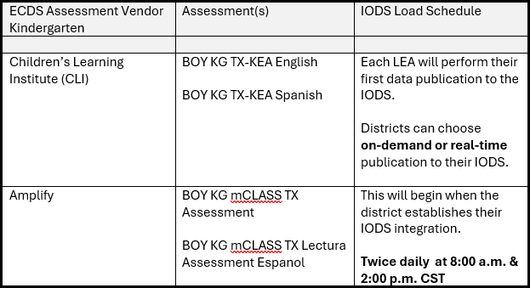
3 – ECDS Loads (KG)

Slide 11
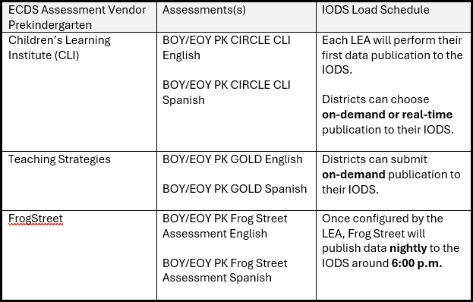
3 – ECDS Loads (PK)

Slide 12
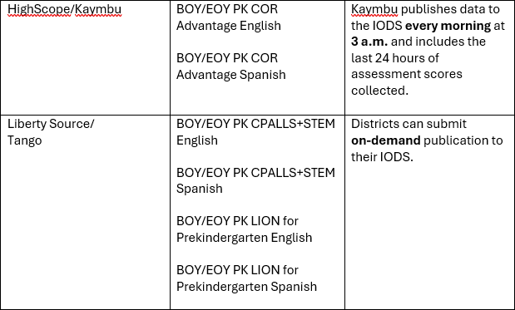
3 – ECDS Loads (PK)

Slide 13
4 – RF Tracker
40115-0007 If DateExitedRF is not blank, then DateExitedRF must be between June 1, 2024 and August 31, 2025.
This is a known issue where the date is 1/1/2099 is showing for the exit date. TEA is planning to release a fix for this issue this week.

Slide 14
5 – Eco Dis and PK Elig
PK Eligibility and Eco Dis are two different things!!
TEA has added updated guidance in TWEDS
(see attached document)
40100-0109 – PK eligible but not coded with qualifier. This has been downgraded to a Special Warning

Slide 15
6-Documents
TSDS Submission Updates
Domain Dependency Resource Documents
JSON Resource Document

Slide 16
7 – Holiday Schedule
TEA: Closing 5PM December 20, 2024, and re-opening 8AM January 2, 2025. There will be no skeleton crew working during this timeframe.
ESC: Closing early December 20, 2024, and returning to regular schedule on January 6, 2025.

Slide 17
8- Comments or Questions

